Slide 1


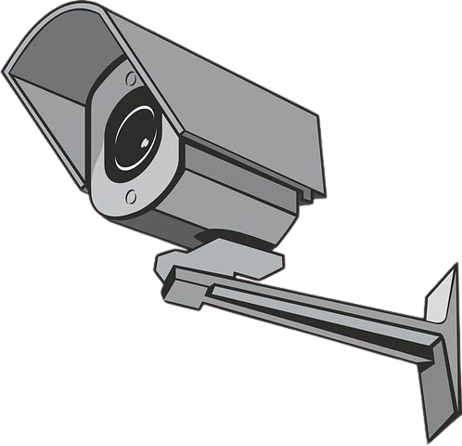
Smart Surveillance Camera
Graduation Project 2024
ID # G6
www.reallygreatsite.com

Slide 2
Smart Surveillance Camera
Page 01
» Introduction
Our Team
Joseph Essa
Shady Abdelaziz
Mohamed Haitham

Slide 3

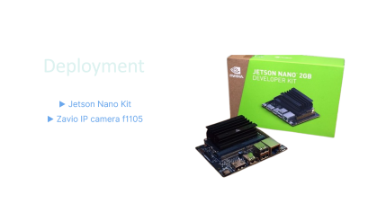


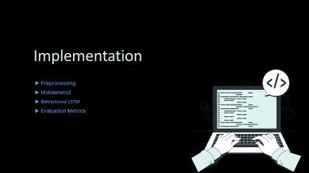
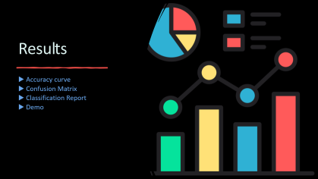
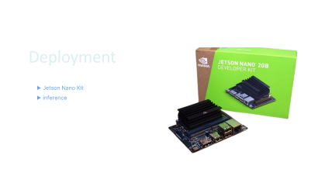




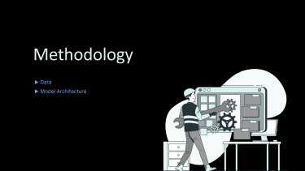
Smart Surveillance Camera
Page 02
TABLE OF CONTENTS
01
02
03
04
Introduction
Background & Motivation
Methodology
Implementation
05
06
07
Jetson Nano
Chat Bot
Results

Slide 4

Introduction
▶ Objective

Slide 5


Smart Surveillance Camera
Page 04
» Introduction
OBJECTIVE
Develop an AI-powered anomaly detection system for surveillance cameras to enhance security and monitoring by automatically identifying unusual or suspicious activities in real-time. The system aims to minimize false positives and false negatives, ensuring high accuracy and reliability. It will leverage advanced machine learning techniques to analyze video feeds, detect anomalies, and provide timely alerts to improve response times and ensure safety in monitored areas.

Slide 6

Background & Motivation
▶ Problem Statement
▶ Motivation
▶ Literature Review

Slide 7

Smart Surveillance Camera
Page 06
» Background
Problem
Statement
Traditional surveillance systems rely on human operators to monitor video feeds, making them prone to fatigue, errors, and delays in detecting suspicious activities. With increasing security demands, there is a need for an automated system that can analyze video feeds in real time and identify anomalies accurately, minimizing false positives and negatives.

Slide 8



Smart Surveillance Camera
Page 07
» Motivation
Why ?!
Security
Automation
Human Operators

Slide 9

Smart Surveillance Camera
Page 08
» Motivation
Literature
Review
▷ Previous works focused mainly on offline detection of specific anomalies like violence, often lacking real-time capability.
▷ Traditional methods were inaccurate, and machine learning required manual features .
▷ Deep learning improved detection but was limited to specific tasks and offline use.

Slide 10

Methodology
▶ Data
▶ Model Architecture

Slide 11
Smart Surveillance Camera
Page 10
» Methodology
Datasets
 | UCF | BOSS | Subway Entrance | Avenue
Number of videos | 1900 | 12 | 1 | 37
Average frames | 7247 | 4052 | 121,749 | 839
Dataset length | 128 hours | 27 min | 1.5 hours | 30 min
Example anomalies | Abuse, arrest, arson, assault, accident, burglary, fighting, robbery | Harass, Disease, Panic | Wrong direction, No payment | Run, throw, new object

Slide 12
Smart Surveillance Camera
Page 11
» Methodology
Dataset Overview
UCF-Crime Dataset
The UCF Crime Dataset is a well-known dataset used for anomaly detection in surveillance video feeds, specifically in identifying criminal or unusual activities. It is widely employed in research on computer vision, particularly for action recognition, anomaly detection, and video surveillance tasks.
Why UCF ?
▷ Real-World Relevance
▷ Diversity of Anomalies
▷ Benchmark for Anomaly Detection
▷ Large-Scale and Challenging

Slide 13
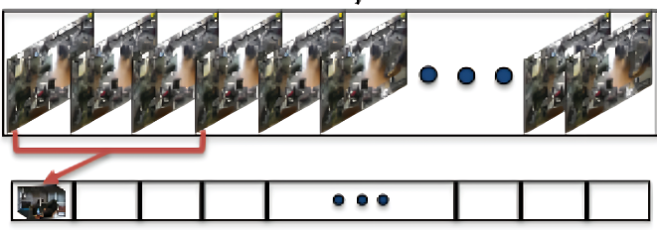
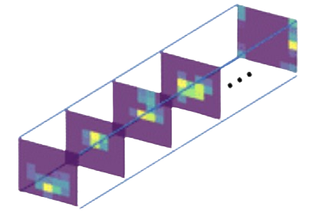
Smart Surveillance Camera
Page 12
» Methodology
Model Architecture
Mobilenetv2 and LSTM Architecture
Anomaly Videos
Feature Map
Anomaly
Normal
Mobilenetv2
Bidirectional LSTM

Slide 14

Implementation
▶ Preprocessing
▶ Mobilenetv2
▶ Bidirectional LSTM
▶ Evaluation Metrics

Slide 15
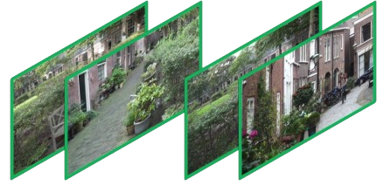
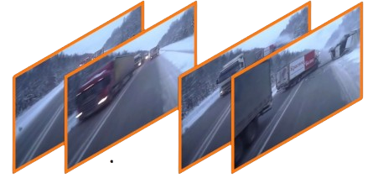
Smart Surveillance Camera
Page 14
» Implementation
Preprocessing
Extract 50 Frame
Label : Normal
Label : Anomaly

Slide 16
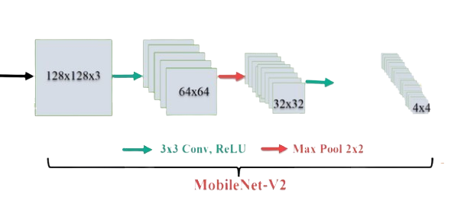
Smart Surveillance Camera
Page 15
» Implementation
Mobilenetv2 Architecture
▹ Input Image (128x128x3) : The input is a colored image of size 128128×128 with 3 channels (e.g., RGB).
▹ Feature Extraction:
A 3×3 convolution is applied, reducing the spatial size while extracting low-level features. The feature map size is now 64×64 and ReLU Activation.
Max Pooling (2x2): A 2×2 max-pooling operation is used to further downsample the feature maps, reducing the size to 32×32.
▹ Feature Downsampling : The process continues with further downsampling using the MobileNetV2 blocks (e.g., inverted residual blocks). the feature map size reduces to 4×4, while the number of channels increases, indicating deeper feature extraction

Slide 17
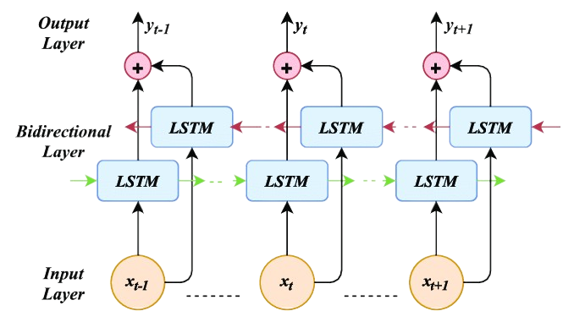
Smart Surveillance Camera
Page 16
» Implementation
Bidirectional LSTM
Bidirectional LSTM : captures temporal dependencies within the sequence of features extracted by MobileNetV2
Forward LSTM : Processes the sequence from start to end
backward LSTM : processes it in reverse. Combining both allows the model to consider past and future contexts at each time step, improving performance for sequence-dependent tasks.

Slide 18
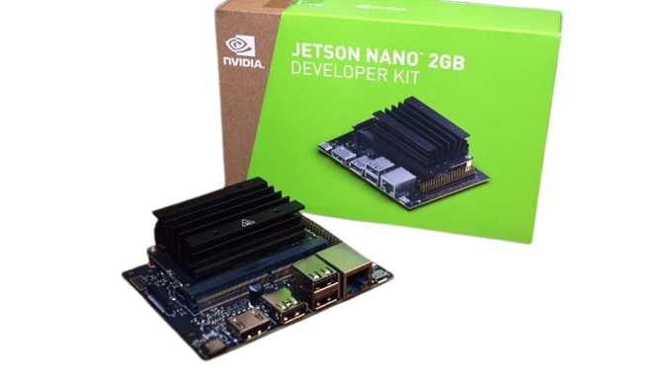
Deployment
▶ Jetson Nano Kit
▶ Zavio IP camera f1105

Slide 19

Smart Surveillance Camera
Page 18
» Deployment
Initialization and Deployment Setup :
Libraries & Configuration: Import ONNX, OpenCV, Google APIs for detection and reporting.
Deployment Hardware:
Deploy on Jetson Nano for edge processing.
Integrate with Zavio F1105 camera for video input.
AI Integration: Configure ONNX for real-time anomaly detection and Generative AI for report generation.
Multithreading for Efficient Processing

Slide 20

Smart Surveillance Camera
Page 19
» Deployment
Real-Time Anomaly Detection
Video Processing:
Capture live video from Zavio F1105 via OpenCV.
Buffer and preprocess frames for anomaly detection.
Anomaly Identification: Use ONNX model on Jetson Nano for low-latency processing.
Real-Time Feedback: Display "Anomaly" or "Normal" labels on the live feed.
Anomaly Detection and Video Recording

Slide 21


Smart Surveillance Camera
Page 20
» Deployment
Post-Detection Actions
Automated Workflow:
Save detected anomaly clips locally on Jetson Nano.
Generate reports using Generative AI.
Upload clips and reports to Google Drive.
Send email notifications for user alerts.
Efficiency: Utilize multithreading to ensure seamless real-time detection and processing without delays.
Report Generation and Notifications

Slide 22
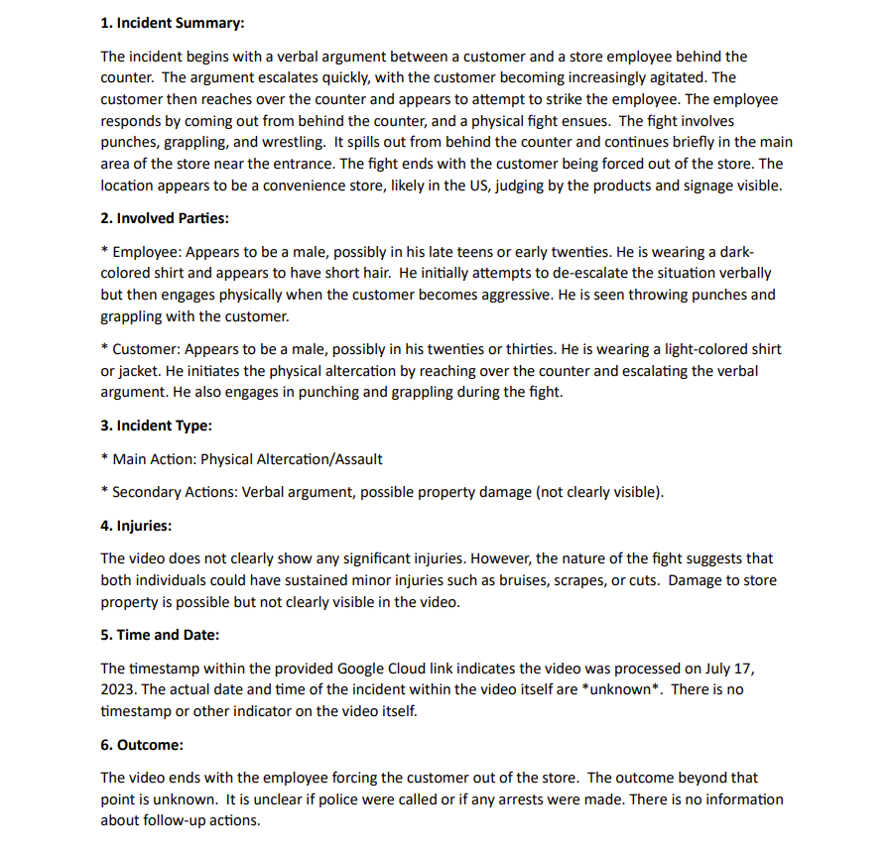
Smart Surveillance Camera
Page 21
» Deployment
Report
Sample

Slide 23

Chat Bot
▶ Chatbot with anomaly videos
▶ Demo
▶ Power Bi

Slide 24
Smart Surveillance Camera
Page 23
» Chat Bot
Chatbot with anomaly videos
Overview of the Anomaly Detection Chatbot with Streamlit and Google Gemini
Project Overview
Objective: Build an anomaly detection chatbot that utilizes Google Gemini (Generative AI) to analyze and respond to user queries related to anomaly reports.
Technologies Used:
Google Gemini API for generative AI-based responses.
Streamlit for creating a user-friendly interface.
ngrok for exposing the local server to the web.
Joblib for saving/loading models.
Key Components:
Google Gemini Integration:
Utilizes Google’s generative AI to interact with users and provide responses based on predefined reports.
Safety settings are configured to allow harmful content (e.g., harassment, hate speech).
Report Management:
Loads anomaly reports stored as .txt files from a specified directory.
The reports are integrated into the chatbot’s context to augment responses based on the provided data.

Slide 25
Smart Surveillance Camera
Page 23
» Chat Bot
Chatbot Interaction and Workflow
Workflow of the Anomaly Detection Chatbot
Report Loading:
The code dynamically loads .txt anomaly reports from a specified folder (REPORT_DIR).
Each report is read and stored in a dictionary to augment responses.
User Interaction:
Users input their queries into the chatbot using Streamlit’s input widget (st.chat_input).
The input is then augmented with the relevant anomaly reports for better context.
AI Response:
The chatbot sends the augmented prompt to Google Gemini for a response.
The response is streamed back and displayed in real-time in the Streamlit interface.
Integration with Streamlit and ngrok:
Streamlit: Provides an easy-to-use interface for interacting with the chatbot and displaying responses in a structured manner.
ngrok: Used for exposing the Streamlit application to the internet, allowing users to access the chatbot remotely for real-time interactions.

Slide 26
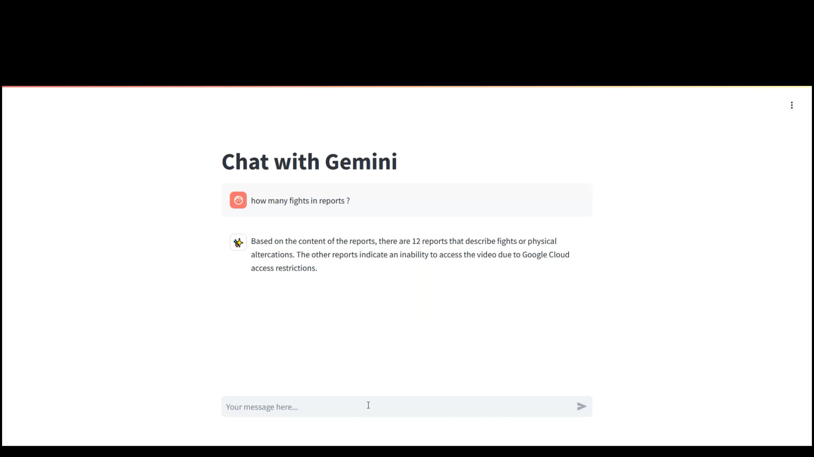
Smart Surveillance Camera
Page 24
» Chat Bot
Demo

Slide 27
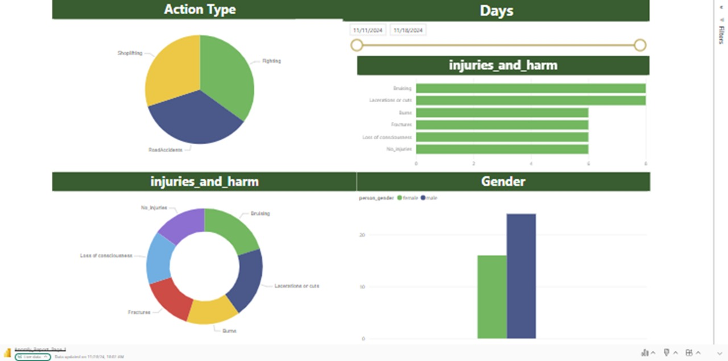
Smart Surveillance Camera
Page 25
» Chat Bot
Power Bi

Slide 28

Results
▶ Accuracy curve
▶ Confusion Matrix
▶ Classification Report
▶ Demo

Slide 29
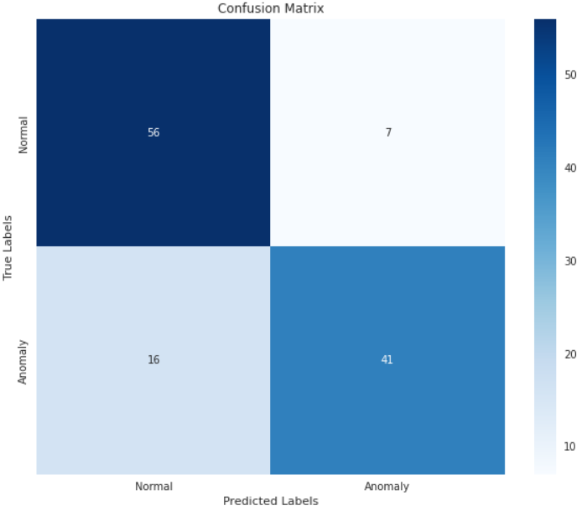


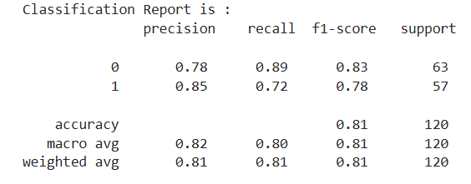
Smart Surveillance Camera
Page 27
» Results
Accuracy
Confusion Matrix
classification report

Slide 30
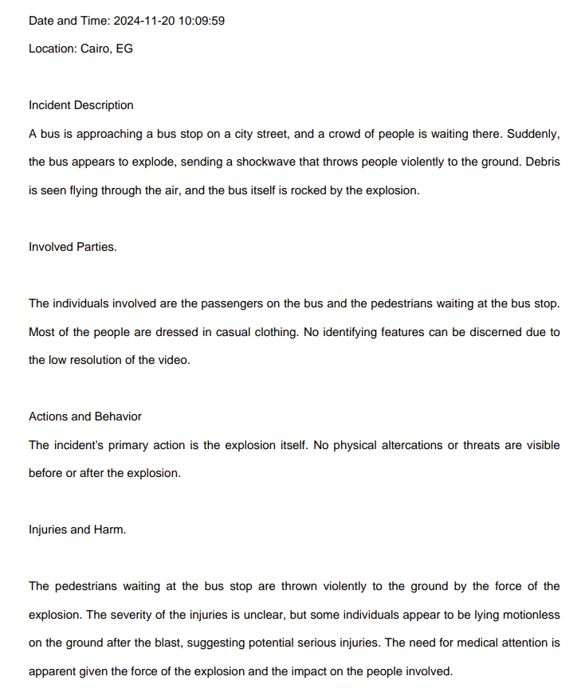
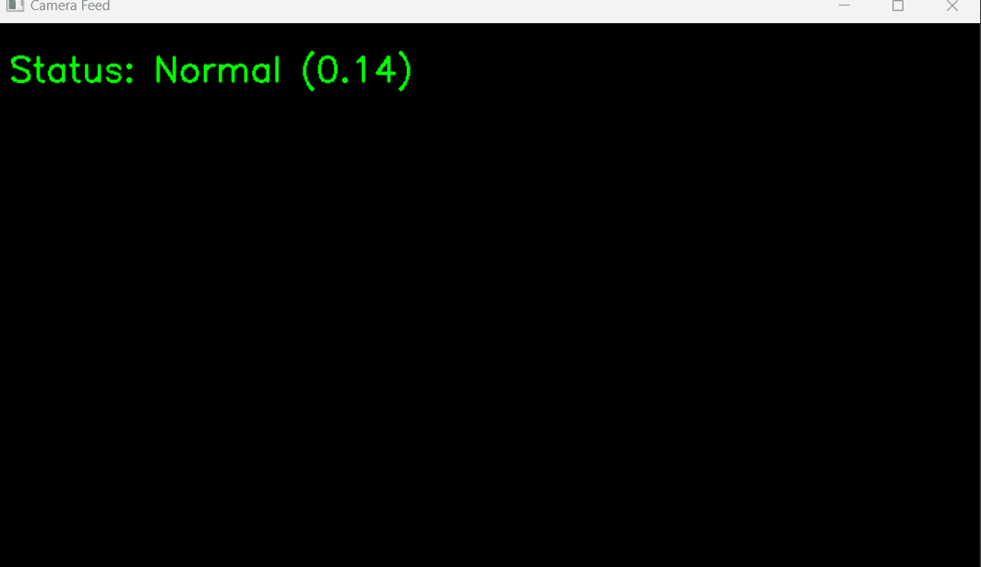
Smart Surveillance Camera
Page 28
» Results
Demo
Anomaly video

Slide 31
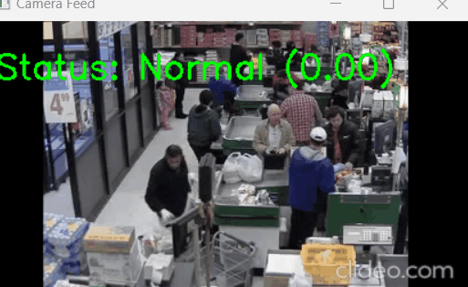
Smart Surveillance Camera
Page 29
» Results
Demo
Normal video

Slide 32

Smart Surveillance Camera
THANK YOU
www.reallygreatsite.com

